Slide 1
Cryptography & Network Security
Cryptography : A word in Greek origin means “ Secret writing”
Cryptography (Basic definition)
  It is the science and art of transforming messages to make them secure and immune to attacks.
Different types of Cryptography
  Symmetric Key Cryptography : Same key will be used for encryption & decryption.
  Asymmetric Key Cryptography: One key will be used for encryption and another key will be used for decryption.

Slide 2
Steganography
Steganography : A word in Greek origin means “ Covered writing”
Steganography (Basic definition)
  Steganography means concealing the message itself by covering it with something else.
Historical Use:
  Messages were carved on pieces of wood and later dipped on the wax to covered writing.
  Messages were written on the thin piece of silk and later swallowed by the messenger.

Slide 3
Steganography
Modern Use
  Text cover: The cover of secret data is Text
  0 1 0 1 0 1
  We have to study about cryptography not steganography
  Image cover: Secret data can also be covered under a color.
  01101110 00001111 10101101 00010101

Slide 4
Goals of Network Security
Privacy or Confidentiality:
  It is used to protect data from disclosure attack.
Authentication:
  It is used to provide authentication of the party at either end of the line.
Integrity:
  It is used to protect data from modification, insertion, deletion etc.
Non-Repudiation:
  This service protects against repudiation either by sender or the receiver.

Slide 5
ITU-T Security Services
International Telecommunication Union- Telecommunication Standardized Sector (ITU-T)
Security Services:
  Data Confidentiality
  Data Integrity
  Authentication
  Non-repudiation
  Access control: It provides protection against unauthorized access to data.

Slide 6
ITU-T Security Mechanisms
ITU-T recommends some security mechanisms to provide the various security services.
Encipherment: It can be used to provide confidentiality. It can also be used to complement other mechanisms. (Cryptography & Steganography)
Data Integrity: It appends a short check value created for the message to be transmitted.
Digital Signature: Sender can electronically sign the data and receiver can electronically verify the signature.
Authentication exchange: Two entities exchange some messages to prove their identity to each other.

Slide 7
ITU-T Security Mechanisms
Traffic Padding: It means inserting some bogus data into the data traffic to thwart traffic analysis.
Routing Control: Selecting and changing different available routes between the sender and the receiver.
Notarization: It means selecting a trusted third party to control the communication between two entities.
Access Control: It gives methods to prove that a user has access right to the data or resources of the system.

Slide 8
Security Attacks
Passive attacks:
  Attacker’s goal is to just obtain the information.
  Attack dose not modify the data or harm the system.
  Snooping: Unauthorized access to or interception of data.
  Traffic analysis: Attempts of analyzing encrypted messages to come up with likely patterns.
Active attacks:
  Attack may change the data or harm the system.
  Modification: The attacker modifies the information.
  Masquerading or Spoofing: It happens when the attacker is posing the identity of somebody else.

Slide 9
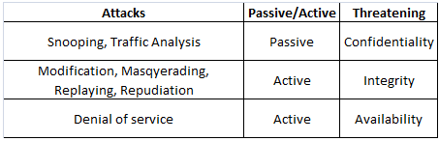
Security attacks
  Replaying: The attacker obtains the copy of the message and later tries to replay it.
  Repudiation: Sender denies that he has send the message or Receiver denies that he has received the message.
  Denial of Service: It may slow down or totally interrupt the service of a system.

Slide 10
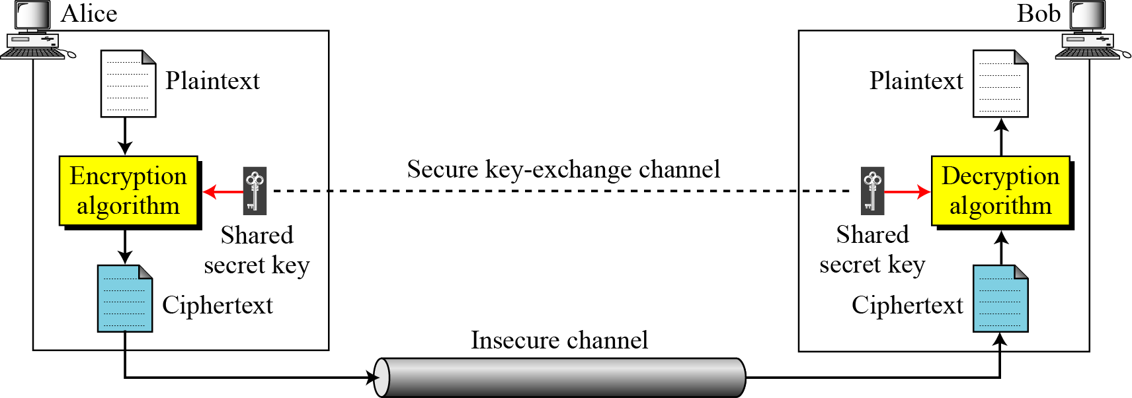
General idea of Symmetric Key Cipher
General idea of symmetric-key cipher
3.<number>

Slide 11
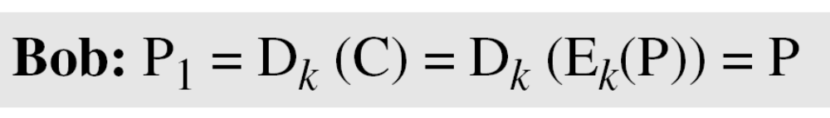
General idea of Symmetric Key Cipher
If P is the plaintext, C is the ciphertext, and K is the key.
3.<number>

Slide 12
Kerckhoff’s Principle
It appears that a cipher is more secure if we hide both the encryption(E)/decryption(D) algorithm and the secret key.
Based on the Kerckhoff’s principle, adversary always know the E/D algorithm.
Resistance of the cipher to attack must be based on the secrecy of the key.
Guessing of the key should be so difficult that there is no need to hide the E/D algorithm.
For modern ciphers, it is require that there key domain should be very large.

Slide 13
Traditional Ciphers
Substitution & Transposition ciphers
Substitution ciphers: We replace one symbol in the ciphertext with another symbol.
Transposition ciphers: We reorder the position of symbols in the plaintext.
Substitution ciphers can be categorized to:
Mono-alphabetic & Poly-alphabetic ciphers.
Mono-alphabetic: The relationship between a character in the plaintext to a character in the ciphertext is one to one.
Poly-alphabetic: The relationship between a character in the plaintext to a character in the ciphertext is one to many.

Slide 14
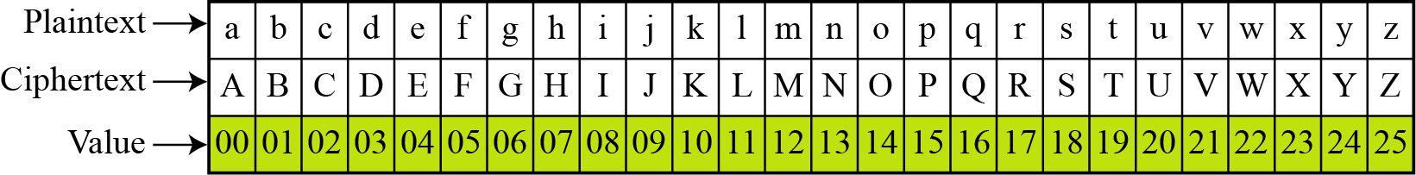
Monoalphabetic cipher- Additive
The simplest mono-alphabetic cipher is the additive cipher. This cipher is sometimes called a shift cipher and sometimes a Caesar cipher(with key 3), but the term additive cipher better reveals its mathematical nature.
Plaintext and Ciphertext in Z₂₆
3.<number>

Slide 15
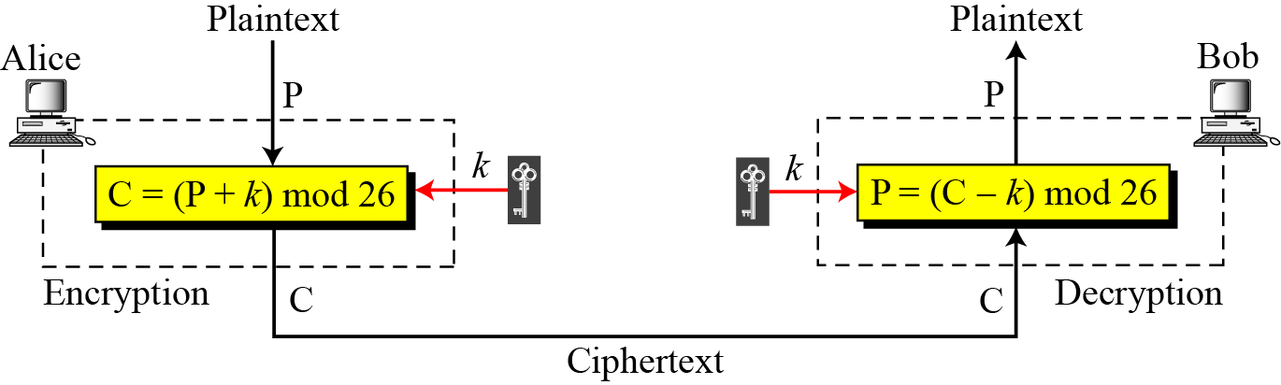
Additive Cipher
When the cipher is additive, the plaintext, ciphertext and key are integers in Z₂₆.
Z: Set of integers.
Z_{n}: Set of nonnegative integers less than n. Ex: Z₅ ={0,1,2,3,4}, Z₂ ={0,1}
3.<number>

Slide 16
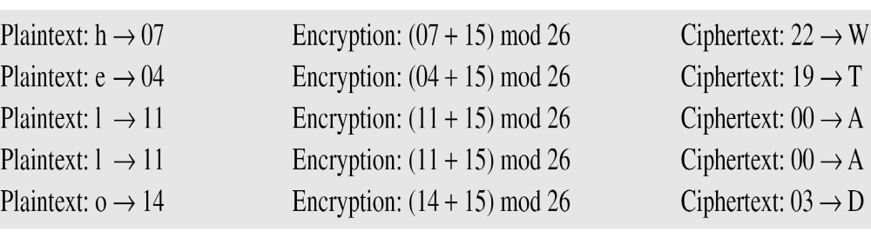
Additive Cipher
Q: Use the additive cipher with key = 15 to encrypt the message “hello”.
We apply the encryption algorithm to the plaintext, character by character:
3.<number>

Slide 17
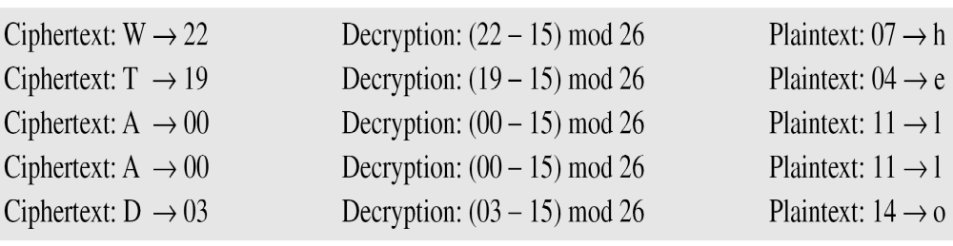
Additive Cipher
Q. Use the additive cipher with key = 15 to decrypt the message “WTAAD”.
We apply the decryption algorithm to the plaintext character by character:
3.<number>

Slide 18
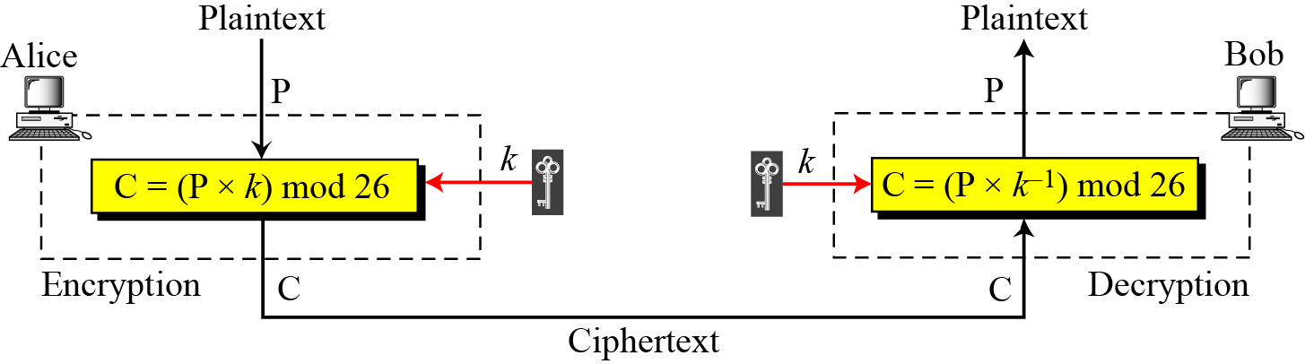
Multiplicative Cipher
In a multiplicative cipher, the plaintext and ciphertext are integers in Z₂₆ and the key is an integer in Z_{26*}.

Slide 19
Multiplicative Cipher
Z_{n*}: Set of nonnegative integers less than n and co-prime to n.
The calculation of Z_{n*} starts after finding the prime factors for n. For ex: When n=26, the prime factors are 2 & 13.
Next, drop the elements which are multiple of prime factor in the range of 1 to (n-1) for given n.
For ex: If n=26, then within a range of 1-26, drop elements which are multiple of 2 & 13.

Slide 20
Multiplicative Cipher
Ques: What is the key domain for any multiplicative cipher?
Ans: The key needs to be in Z₂₆*. This set has only 12 members: 1, 3, 5, 7, 9, 11, 15, 17, 19, 21, 23, 25.
The set Z₈* has only 4 members: 1,3,5,7. The key pairs are
(1,1) as 1x1 mod 8=1
(3,3) as 3x3 mod 8=1
(5,5) as 5x5 mod 8=1
(7,7) as 7x7 mod 8=1

Slide 21
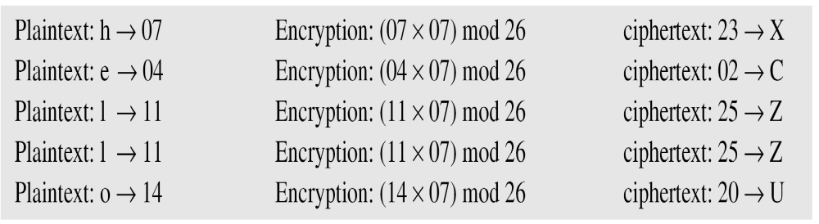
Multiplicative Cipher
Ques: Use a multiplicative cipher to encrypt the message “hello” with a key of 7. The ciphertext is “XCZZU”.

Slide 22
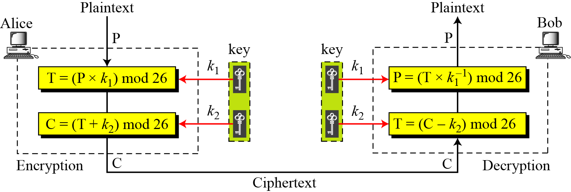
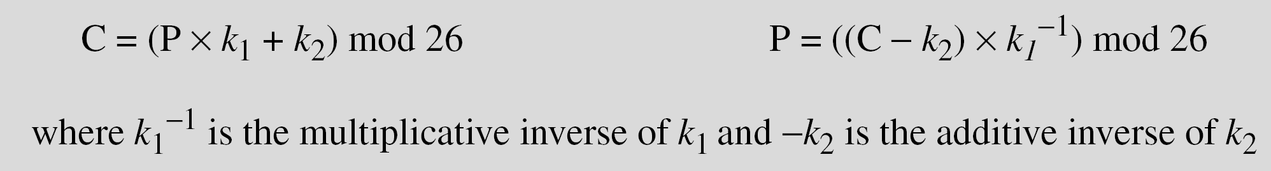
Affine Cipher

Slide 23
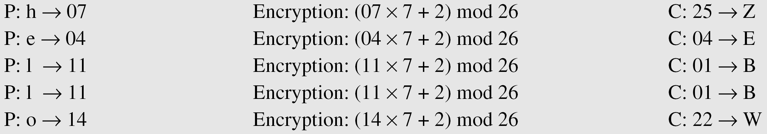
Affine Cipher
The affine cipher uses a pair of keys in which the first key is from Z₂₆* and the second is from Z₂₆. The size of the key domain is
26 × 12 = 312.
Ques: Use an affine cipher to encrypt the message “hello” with the key pair (7, 2).

Slide 24
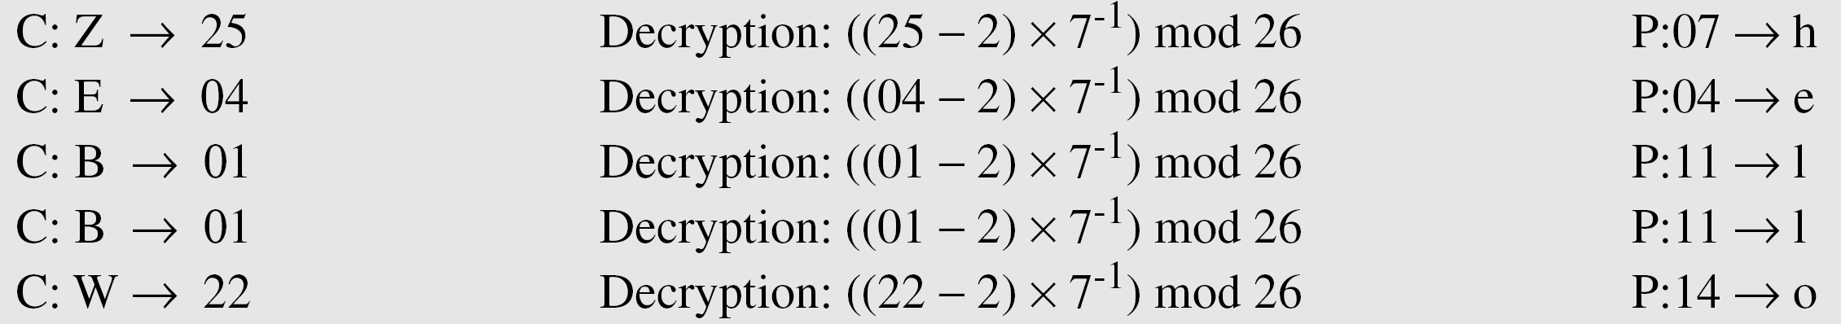
Affine Cipher
Ques: Use the affine cipher to decrypt the message “ZEBBW” with the key pair (7, 2) in modulus 26.

Slide 25
Poly-alphabetic Cipher (Auto Key Cipher)
Here the key is a stream of sub-keys where the first sub-key is predetermined value secretly agreed between sender and receiver.
The second sub-key is the value of the first plaintext, third sub-key is the value of the second plaintext and so on.

Slide 26
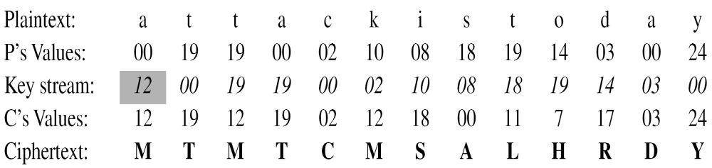
Auto Key Cipher
Ques: Alice and Bob agreed to use an autokey cipher with initial key value k1 = 12 to encrypt the message “Attack is today”.

Slide 27
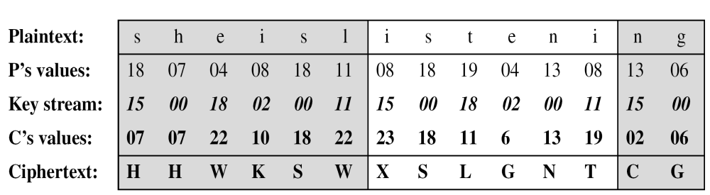
Vigenere Cipher
Here the key stream is the repetition of the initial secret key.
Ques: Encrypt the message “She is listening” using the 6-character keyword “PASCAL”.
Initial key stream is (15,0,18,2,0,11)

Slide 28
Playfair Cipher
The secret key is made up of 25 characters arranged in 5x5 matrix. (I and J assumed same meaning).
Before encryption:
The entire message is divided into a pair of characters. If two letters in a pair are the same, a bogus letter is inserted to separate them. Finally number of characters should be even.
Encryption Rules:
If two letters are in same row, encrypted letters are right to it.
If two letters are in column, encrypted letter are beneath to it.
If two letters are not in same row or column, the corresponding encrypted for each letter is in its row but in the same column as other.

Slide 29
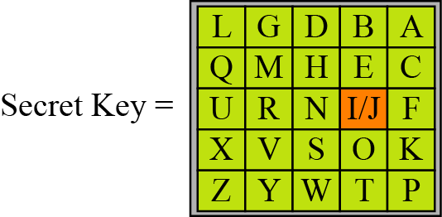
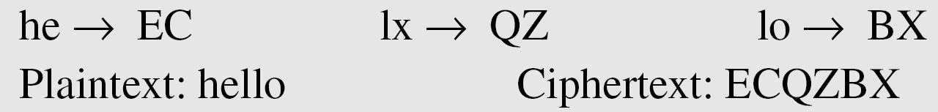
Playfair Cipher
Ques: Encrypt the plaintext “hello” using the key given above.

Slide 30
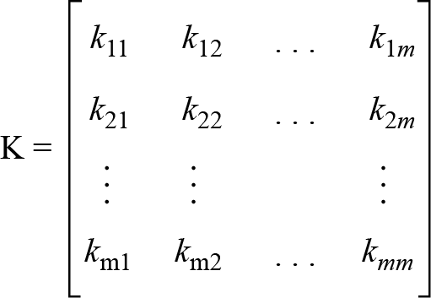
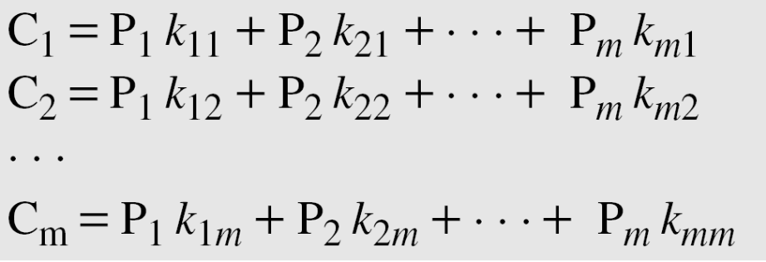
Hill Cipher
The plaintext is divided into equal size blocks.
The blocks are encrypted one at a time, such that each character in the block contributes to the encryption of the other characters of the block.
In Hill cipher, the key is a square matrix of size m x m in which m is the size of the block.

Slide 31
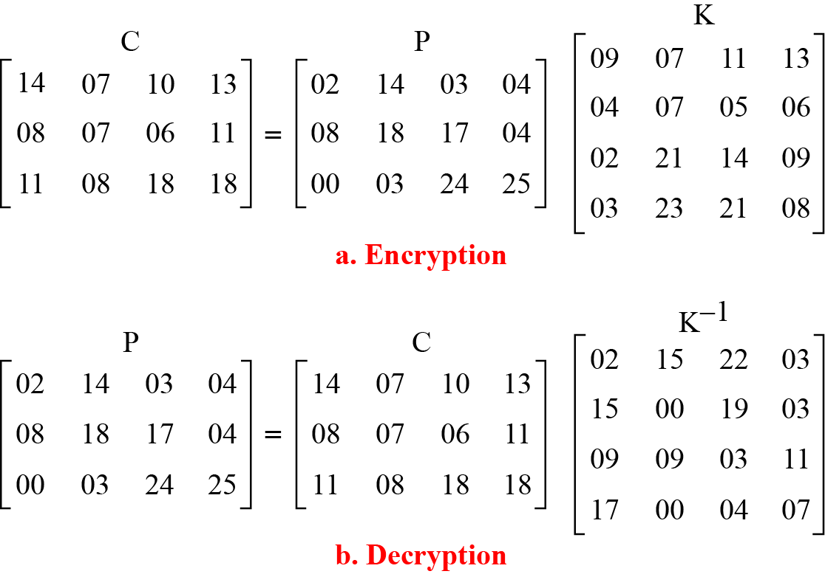
Hill Cipher
For example, the plaintext “code is ready” can make a 3 × 4 matrix when adding extra bogus character “z” to the last block and removing the spaces. The ciphertext is “OHKNIHGKLISS”.

Slide 32
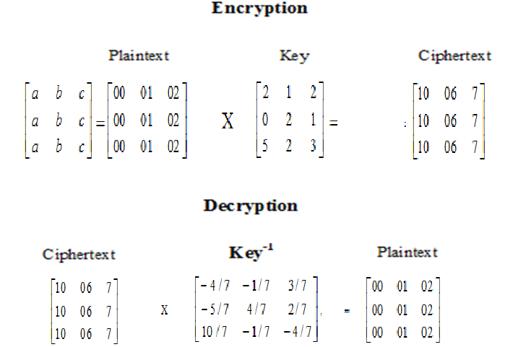
Hill Cipher

Slide 33
Transposition Cipher-Keyless Transposition Cipher
There are two methods for permutation of characters.
Text is written column by column and then transmitted row by row.
Text is written row by row and then transmitted column by column.
A good example of the first method is the Rail Fence Cipher.
For example: Meet me at the park
She then creates the ciphertext “MEMATEAKETETHPR”.

Slide 34

Keyless Transposition Cipher
Alice and Bob can agree on the number of columns and use the second method. Alice writes the same plaintext, row by row, in a table of four columns.
She then creates the ciphertext “MMTAEEHREAEKTTPZ”.

Slide 35
Keyed Transposition Cipher
Another method is to divide the plaintext into groups of predetermined size called blocks.
Then key is used to permute the characters in each block separately.
Alice needs to send the message “Enemy attacks tonight” to Bob.

Slide 36
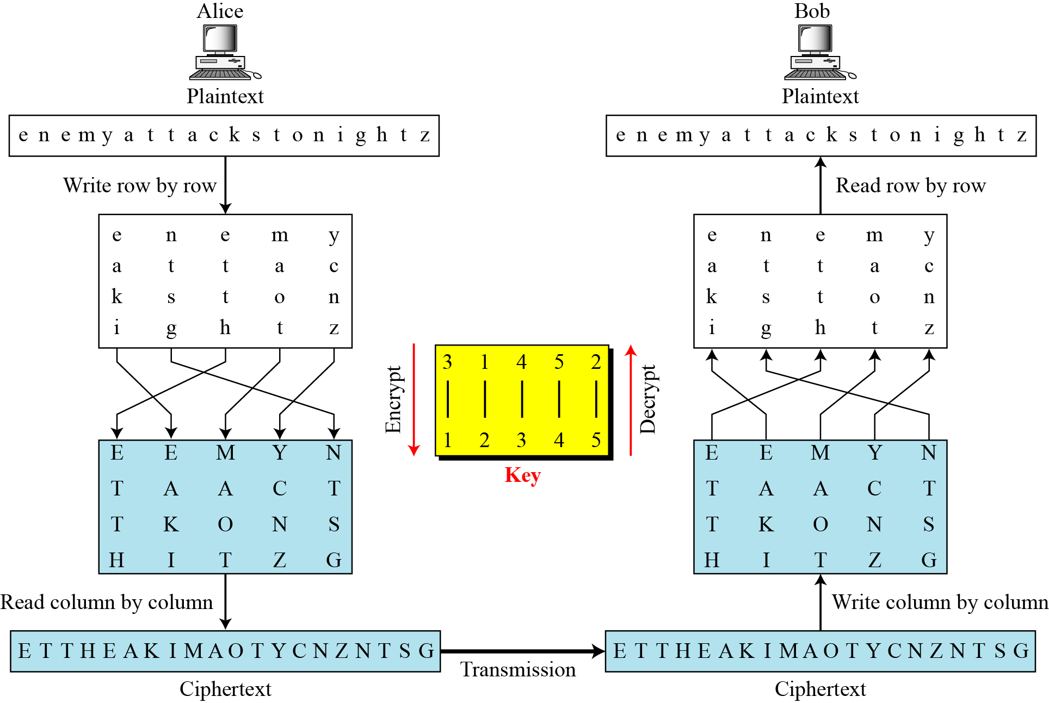
Combining Two Approaches
Most recent transposition ciphers combine the two approaches to achieve better scramble.

Slide 37
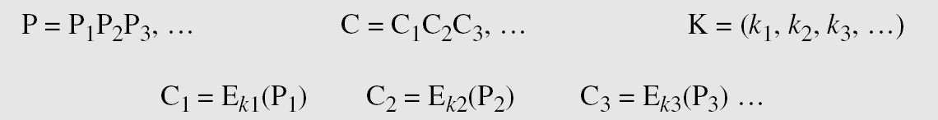
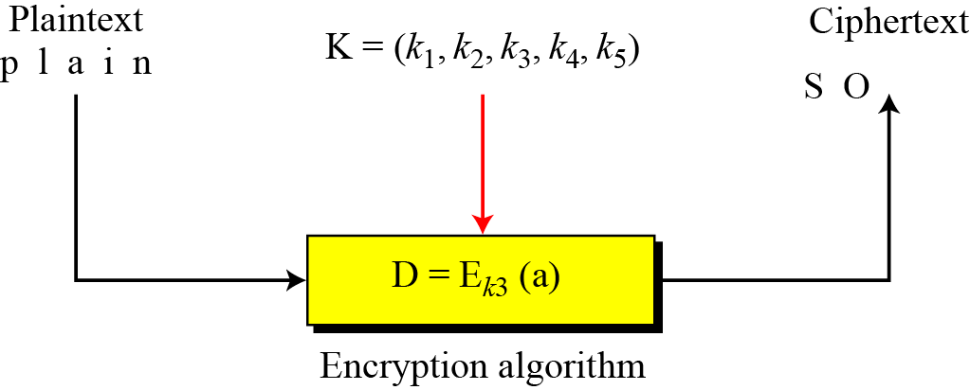
Stream Ciphers
Plaintext stream (P), Ciphertext stream(C), and the key stream (K)

Slide 38
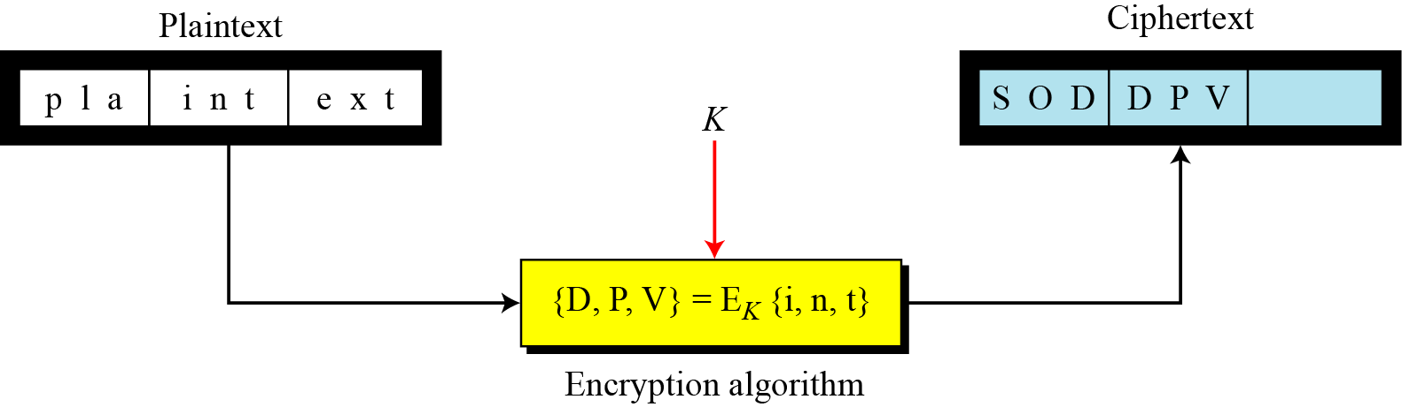
Block Ciphers
In a block cipher, a group of plaintext symbols of size m (m > 1) are encrypted together creating a group of ciphertext of the same size.

Slide 39
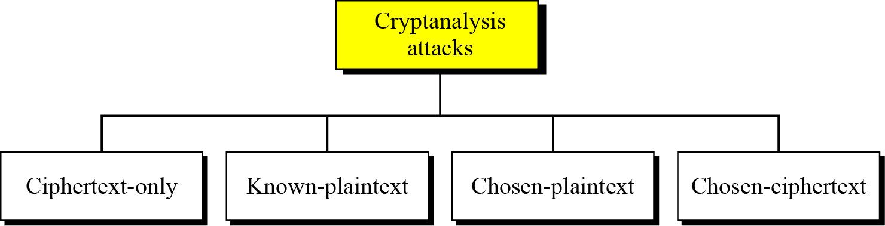
Cryptanalysis
As cryptography is the science and art of creating secret codes, Cryptanalysis is the science and art of breaking those codes.

Slide 40
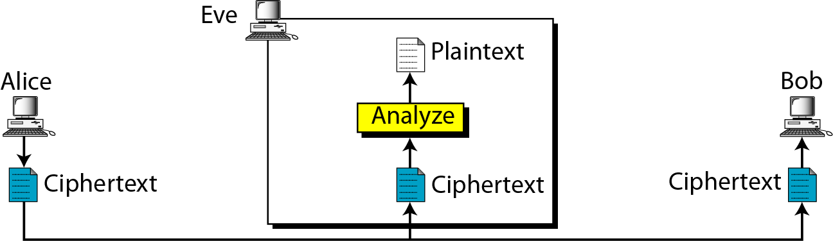
Ciphertext Only Attack
Here the assumption is that Eve knows the algorithm and can intercept the ciphertext.

Slide 41
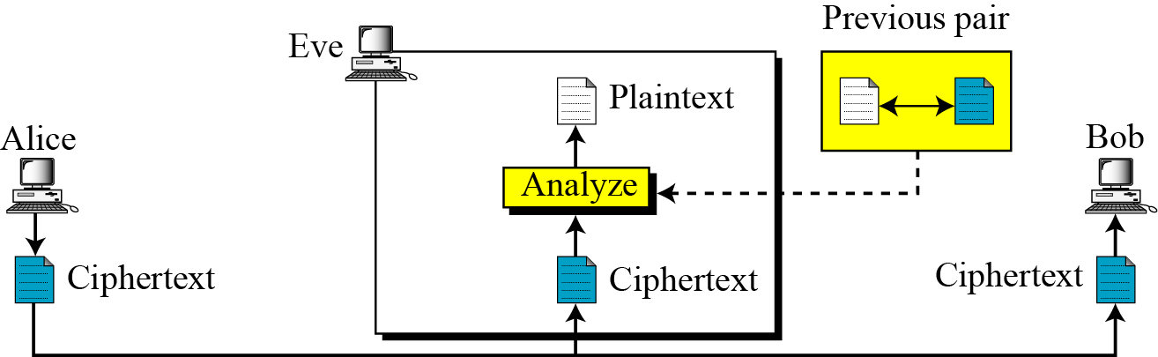
Known-Plaintext Attack
Eve has access to some plaintext/ciphertext pairs in addition to the intercepted ciphertext. (Less likely to happen)

Slide 42
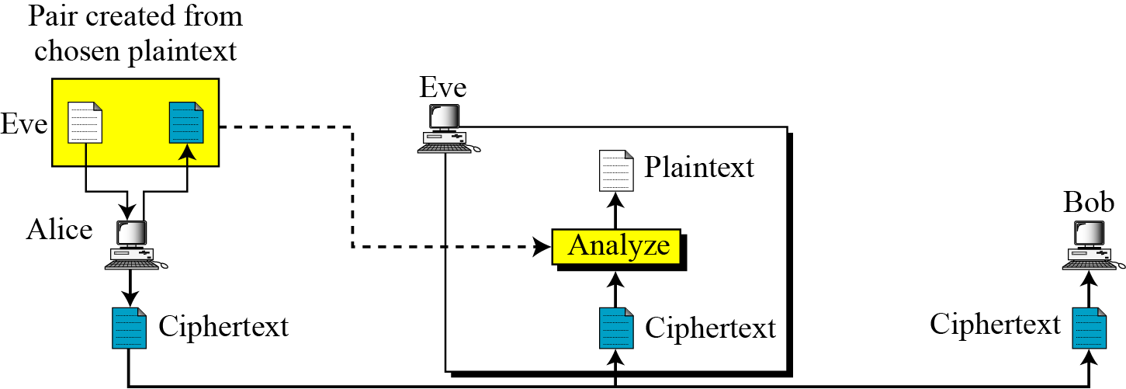
Chosen- Plaintext Attack
Similar to known-plaintext attack except the plaintext/ciphertext pairs have been chosen by the attacker. (Less likely to happen)

Slide 43
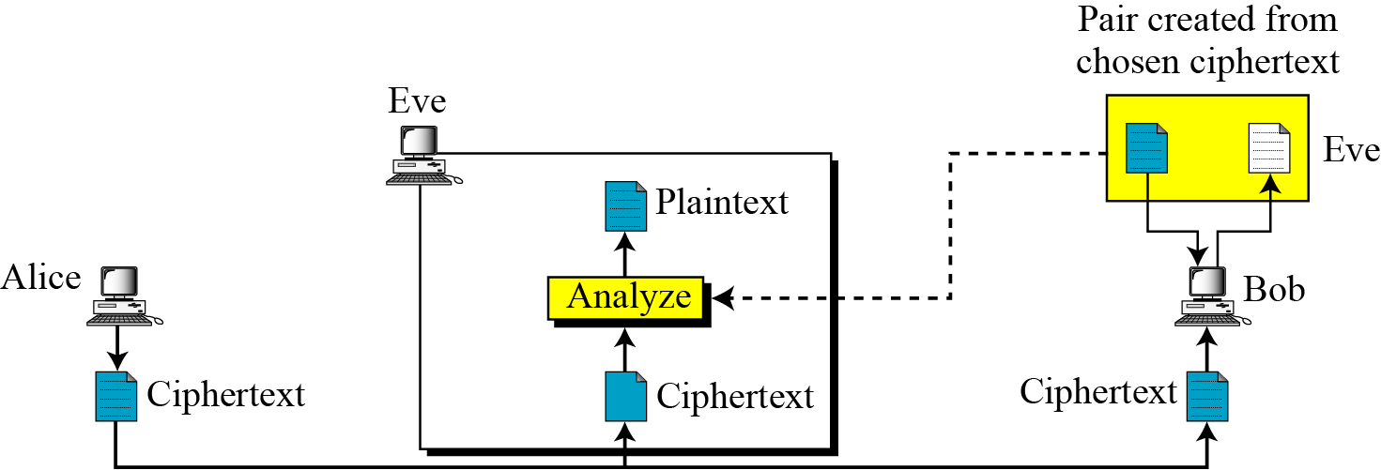
Chosen-Cipher Attack
Similar to known-plaintext attack except the ciphertext/plaintext pairs have been chosen by the attacker. (Less likely to happen)

Slide 44
Modern Block Cipher
Modern block ciphers can be Stream or Block.
Modern block ciphers are based on bit level data.
However traditional ciphers are all based on character level data.
Stream ciphers takes each data bit by bit for encryption.
Block ciphers takes block of data for encryption/decryption.

Slide 45
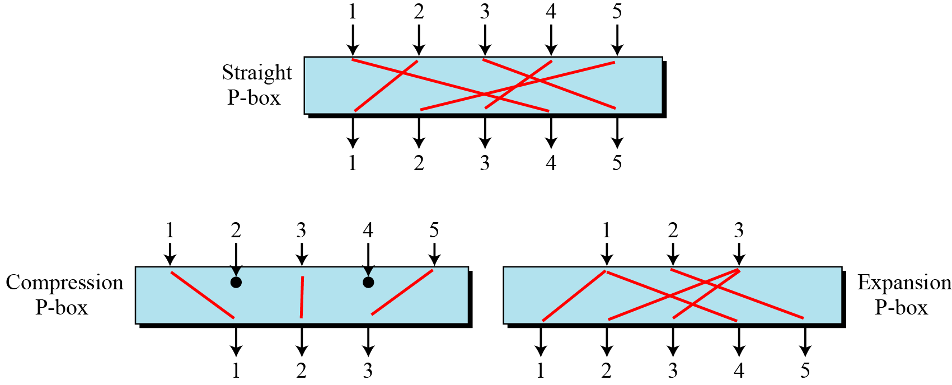
Components of Modern Block Cipher
A P-box (permutation box) parallels the traditional transposition cipher for characters. It transposes bits.
Three types of P-boxes

Slide 46
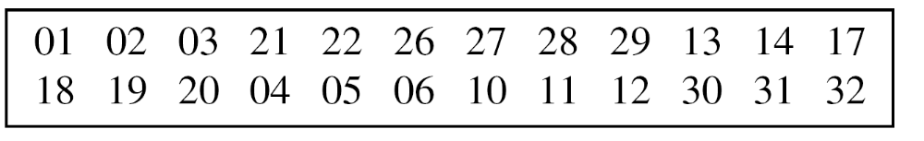
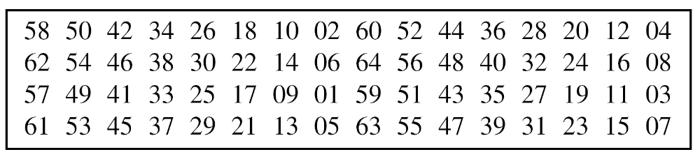
Few examples for P-box
Example of a 32 × 24 compression P-box
Example of a 64 x 64 straight P-box

Slide 47
Substitution box (S-box)
An S-box is an m × n substitution unit, where m and n are not necessarily the same.
The following table defines the input/output relationship for an S-box of size 3 × 2.
The leftmost bit of the input defines the row; the two rightmost bits of the input define the column.
The two output bits are values on the cross section of the selected row and column.

Slide 48
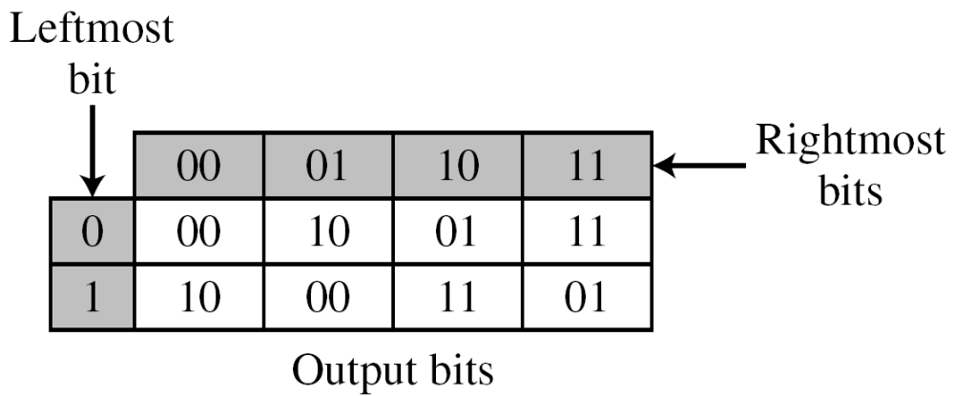
Substitution box (S-box)
Based on the table, an input of 010 yields the output 01. An input of 101 yields the output of 00.

Slide 49
Product cipher
A product cipher is a complex cipher combining substitution, permutation, and other components.
Diffusion
The idea of diffusion is to hide the relationship between the ciphertext and the plaintext.
Confusion
The idea of confusion is to hide the relationship between the ciphertext and the key.

Slide 50
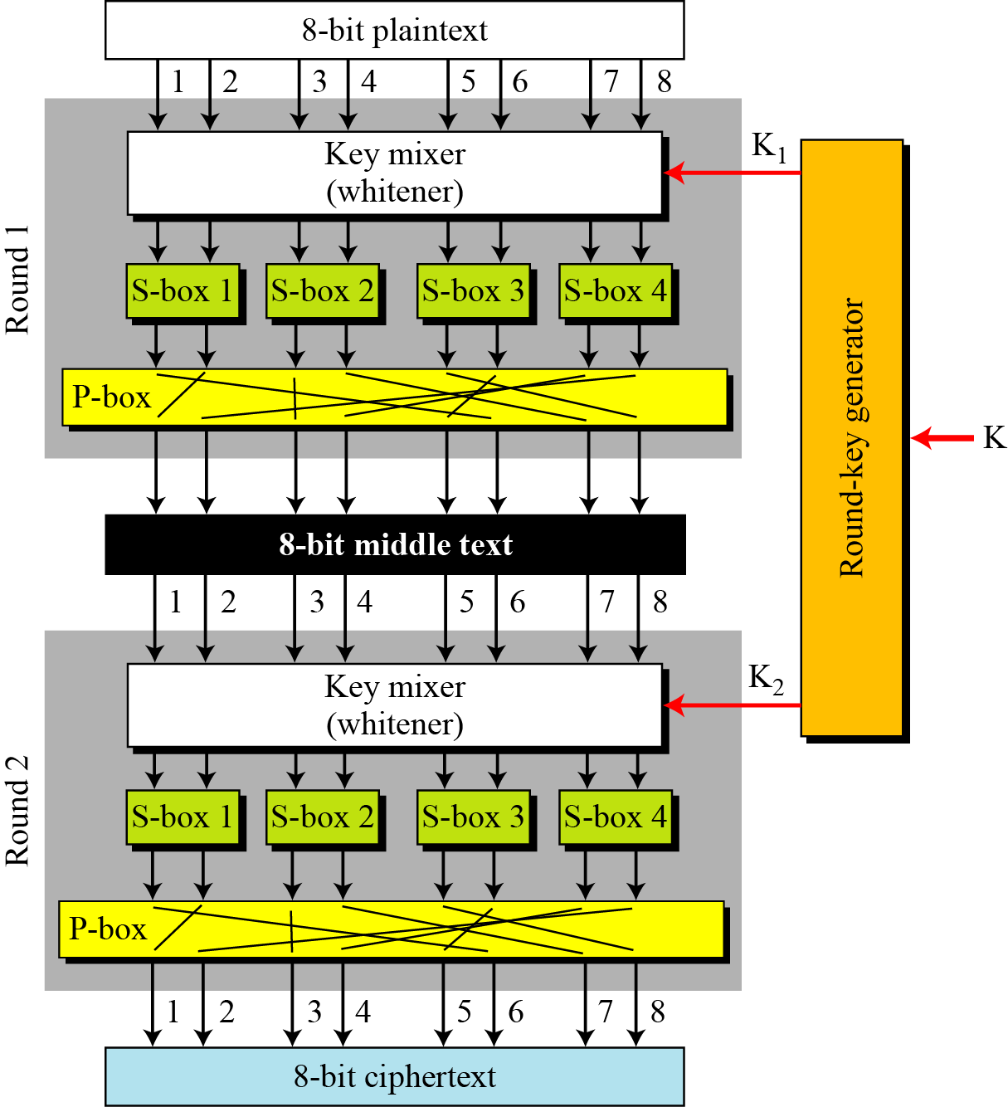
Product cipher of two rounds

Slide 51
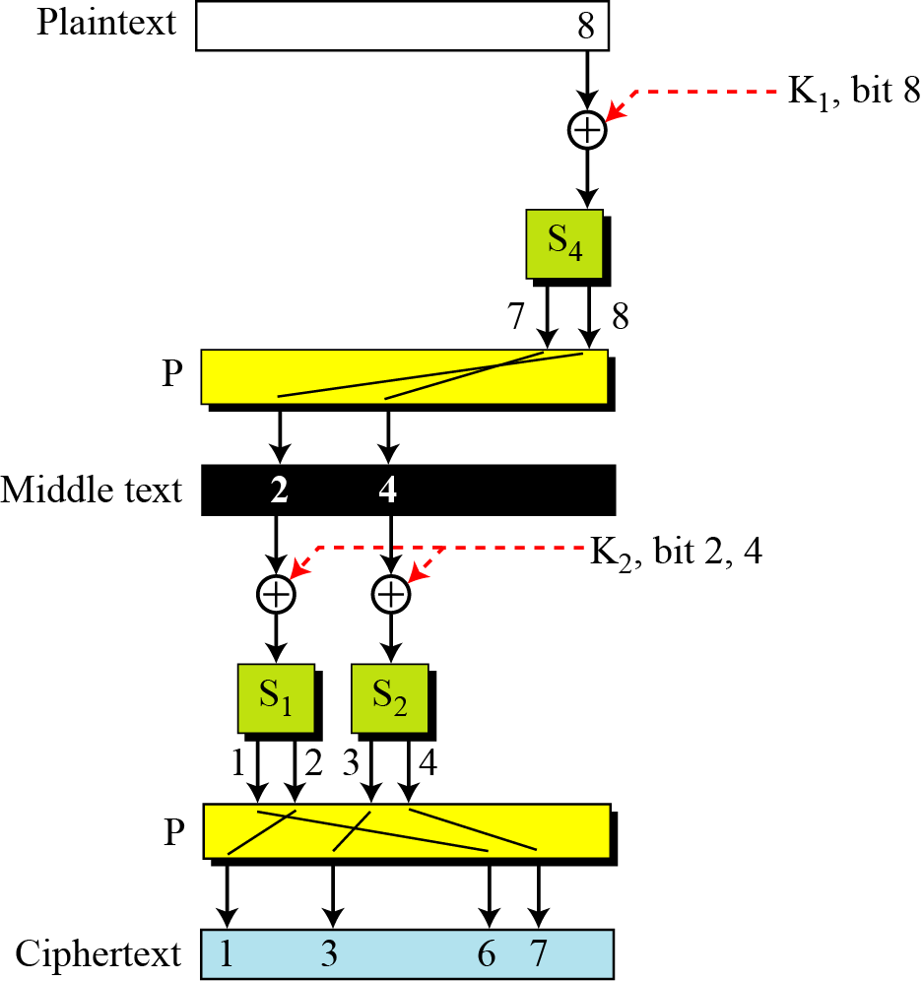
Diffusion and confusion in a block cipher

Slide 52
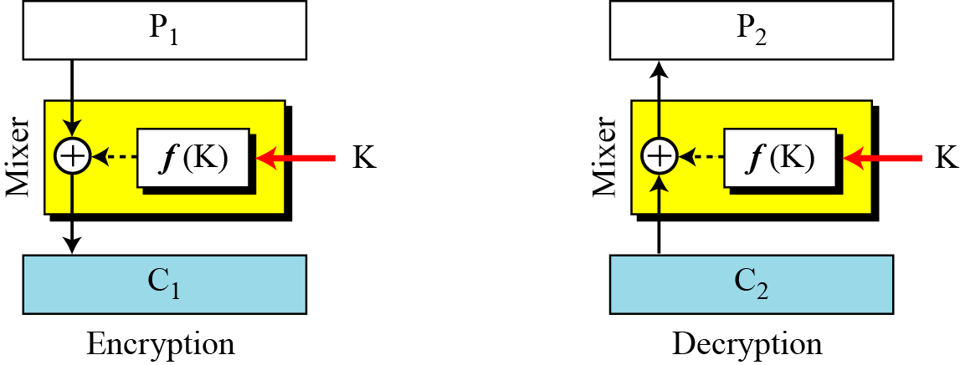
Class of Product ciphers
Feistel ciphers – DES algorithm
Non-Feistel ciphers- AES algorithm
A Feistel cipher make uses of both invertible, self-invertible and non-invertible components.
First thought

Slide 53
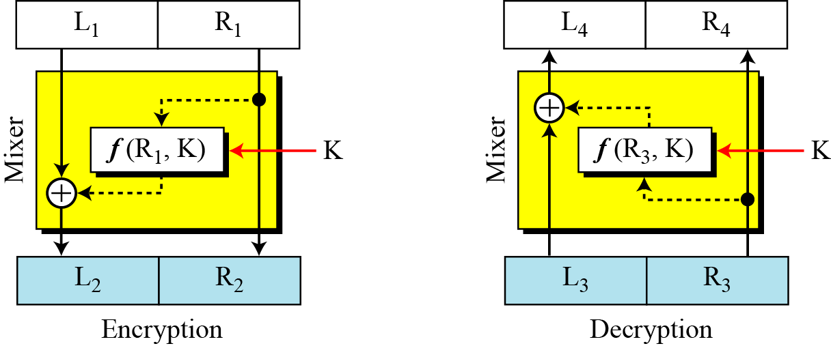
Feistel Cipher
Here we want the input to the function to be also be a part of plaintext/ciphertext apart from key.
Improvement in Feistel cipher design
Improvement

Slide 54
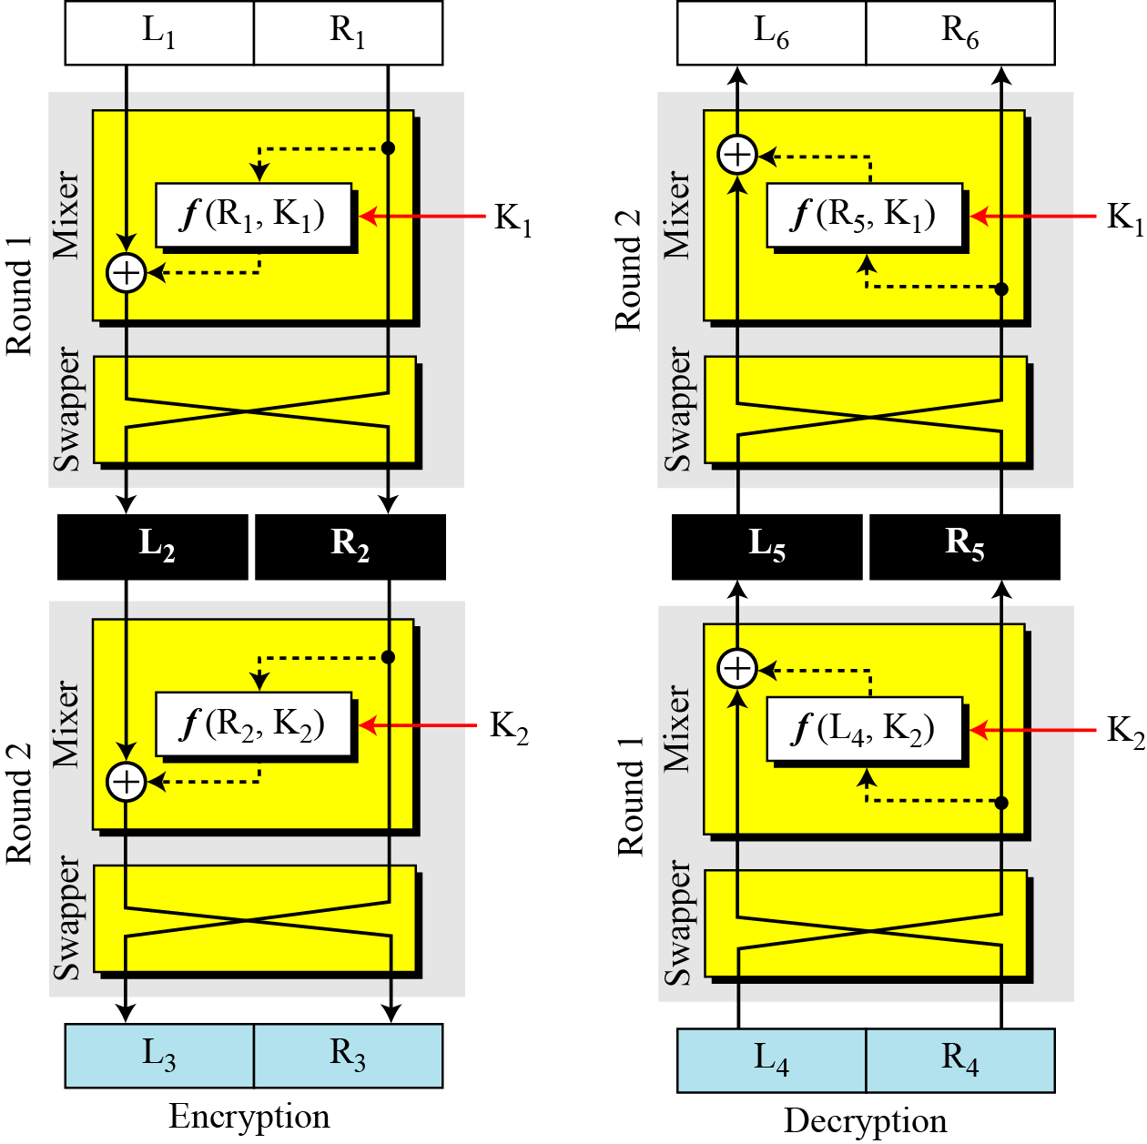
Feistel Cipher
Final design

Slide 55

DES (Data Encryption Standard) cipher
DES is a block cipher, as shown in Figure.

Slide 56

General structure of DES

Slide 57

Initial and Final Permutation

Slide 58
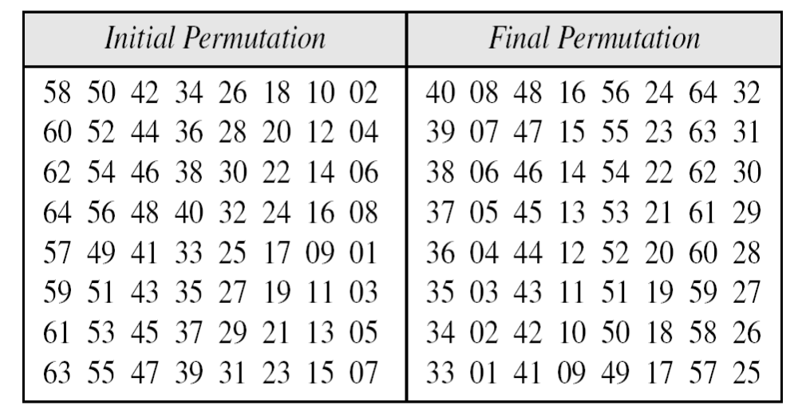
Initial and Final Permutation Table

Slide 59

DES Key generation

Slide 60
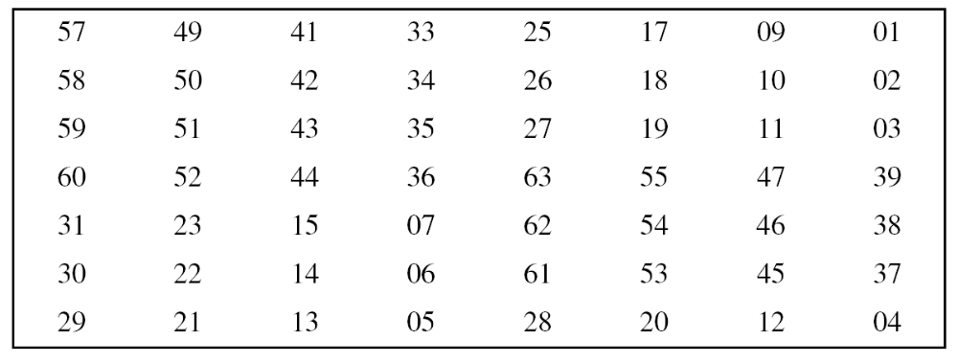
DES Key generation
Parity-bit drop table
Number of bits shifts

Slide 61
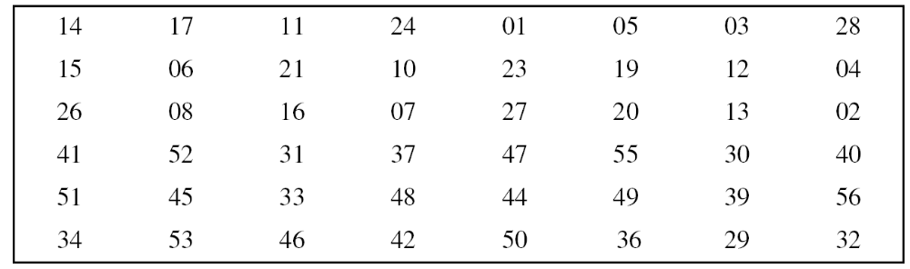
DES Key generation
Key-compression table

Slide 62
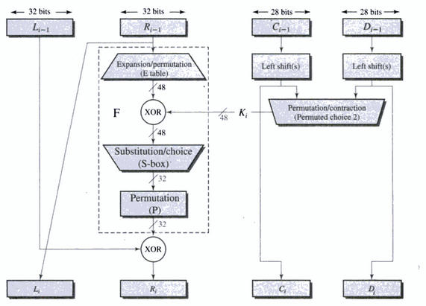

DES Round Structure

Slide 63
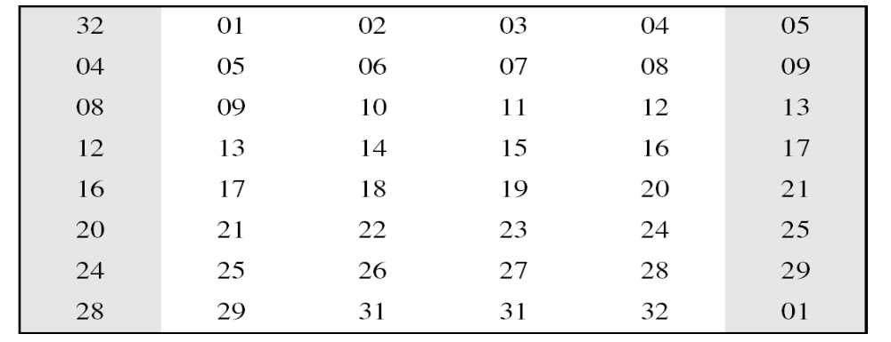
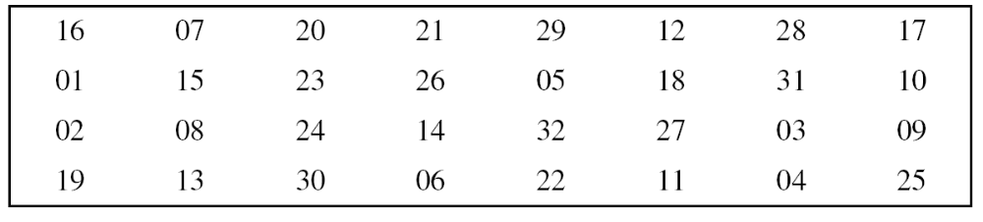
DES Round Structure
Expansion P-box table
Straight permutation table

Slide 64

DES S-box design

Slide 65

DES S-box
S-box 1
The input to S-box 1 is 100011. What is the output?
If we write the first and the sixth bits together, we get 11 in binary, which is 3 in decimal. The remaining bits are 0001 in binary, which is 1 in decimal. We look for the value in row 3 & column 1 of the Table of S-box 1. The result is 12 in decimal, which in binary is 1100. So the input 100011 yields the output 1100.

Slide 66


Avalanche effect
A small change in either the plaintext or the key, should produce the significant change in the ciphertext.
State 1:
Two plaintext that differ by one bit were used:
State 2:
Single plaintext input with two different key :

Slide 67
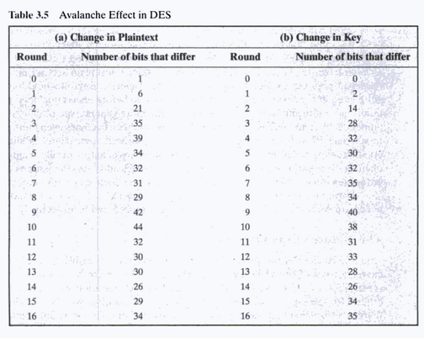
Avalanche effect

Slide 68
Strength of DES
The use of 56-bit keys:
With a key length of 56 bits, there are
which is equivalent to
Nature of DES algorithm
The design of algorithm specially the design of S-boxes are not made public.
Timing Attacks
Timing attack is one in which information about the key or plaintext is obtained by observing how long it takes to perform decryption on various ciphertexts.

Slide 69
Block Cipher Modes of Operation
To apply DES in variety of applications, different modes of operation have been defined.
Electronic Codebook(ECB)
Cipher Block Chaining(CBC)
Cipher Feedback(CFB)
Output Feedback(OFB)
Counter (CTR)

Slide 70
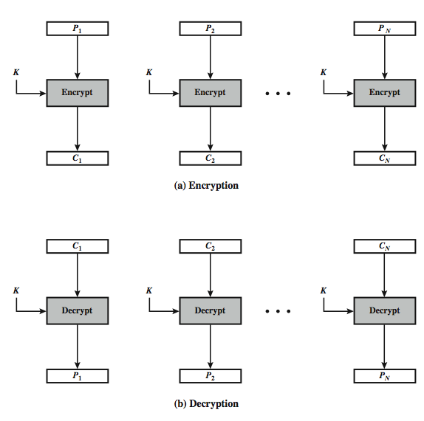
Electronic Codebook Mode
The term codebook is used because for a given key, there is a unique ciphertext for every 64 bit of plaintext.

Slide 71
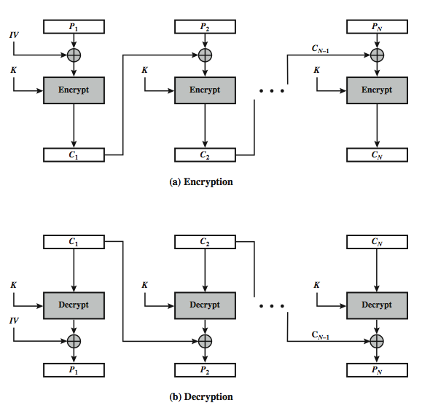
Cipher Block Chaining Mode
Input to the encryption algorithm is the XOR of the current plaintext block and the preceding ciphertext block.

Slide 72
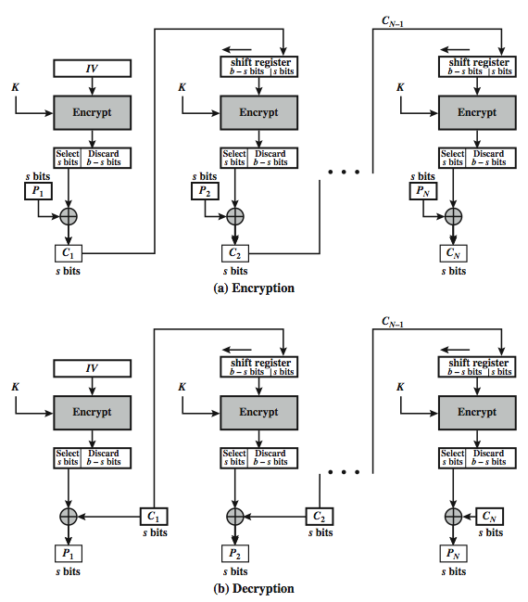
Cipher Feedback Mode
To convert DES into stream cipher , Cipher feedback or output feedback mode is used.

Slide 73
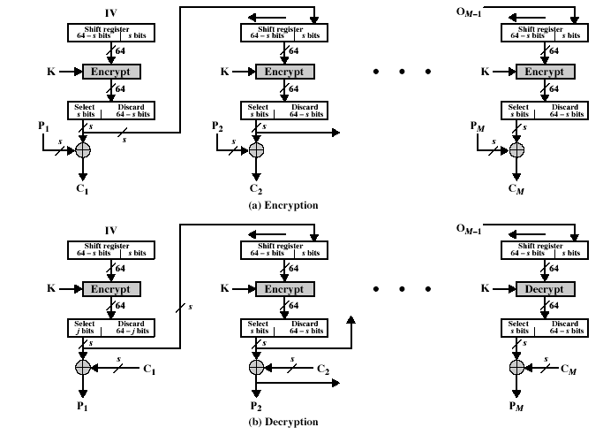
Output Feedback Mode

Slide 74

Counter Mode
A counter equal to plaintext block size is used and counter value must be different for each plaintext block that is encrypted.

Slide 75
Triple DES
Triple DES with Two keys:
  C = E_{K1}(D_{K2}(E_{K1}(P)))
Triple DES with Three keys:
  C = E_{K3}(D_{K2}(E_{K1}(P)))

Slide 76

AES Versions

Slide 77

AES Basic Structure

Slide 78

AES Data Structure

Slide 79

Substitute Bytes

Slide 80

Substitute Bytes

Slide 81

Substitute Bytes

Slide 82

Shift Rows

Slide 83

Shift Rows

Slide 84

Mix Columns

Slide 85


Mix Columns

Slide 86


Add Round Key Transformation

Slide 87

AES Key Expansion

Slide 88


AES Key Expansion

Slide 89

Modular Arithmetic
Modulo operator
The modulo operator is shown as mod. The second input (n) is called the modulus. The output r is called the residue.
Fig: Division relation and modulo operator

Slide 90

Modulo operator
Find the result of the following operations:
a. 27 mod 5 b. 36 mod 12
c. −18 mod 14 d. −7 mod 10
Set of Residues: The modulo operation creates a set, which in modular arithmetic is referred to as the set of least residues modulo n, or Z_{n}.
Figure: Some Z_{n} sets

Slide 91

Congruence
To show that two integers are congruent, we use the congruence operator ( ≡ ). For example, we write:
Figure: Concept of congruence

Slide 92

Additive Inverse
In Z_{n}, two numbers a and b are additive inverses of each other if
Find all additive inverse pairs in Z10.
The ten pairs of additive inverses are (0, 0), (1, 9), (2, 8), (3, 7), (4, 6), (5, 5), (6, 4), (7, 3) (8, 2), (9, 1).

Slide 93

Multiplicative Inverse
In Z_{n}, two numbers a and b are the multiplicative inverse of each other if
Find all multiplicative inverse pairs in Z₇.
We have six pairs: (1, 1), (2, 4), (3, 5), (4, 2), (5, 3), and (6, 6).
Two numbers a & b are relative prime or co-prime to each other if
Gcd (a, b) = 1

Slide 94
Euclidean Algorithm
Euclidean algorithm is used to find the GCD of two numbers.
It is based on two facts:
Fact 1: gcd(a,0)=a
Fact 2: gcd(a,b)=gcd(b,r) where r is the remainder after dividing a by b.

Slide 95

Euclidean Algorithm
Find the greatest common divisor of 2740 and 1760.
We have gcd (2740, 1760) = 20.

Slide 96

Extended Euclidean Algorithm
Given two integers a and b, we often need to find other two integers, s and t, such that
The extended Euclidean algorithm can calculate the gcd (a, b) and at the same time calculate the value of s and t.

Slide 97

Extended Euclidean Algorithm

Slide 98
Extended Euclidean Algorithm
Given a = 161 and b = 28, find gcd (a, b) and the values of s and t.
We get gcd (161, 28) = 7, s = −1 and t = 6.

Slide 99
Extended Euclidean Algorithm
The extended Euclidean algorithm finds the multiplicative inverses of b in Z_{n} when n and b are given and gcd (n, b) = 1.
Find the multiplicative inverse of 11 in Z₂₆.
The gcd (26, 11) is 1; the inverse of 11 is −7 or 19.

Slide 100

Prime number
Figure : Three groups of positive integers
A prime is divisible only by itself and 1.

Slide 101
Euler’s Phi Function
Euler’s phi-function, φ (n), which is sometimes called the
Euler’s totient function finds the number of integers that are both smaller than n and relatively prime to n.
What is the value of φ(13)?
13 is a prime, φ(13) = (13 −1) = 12.

Slide 102
Euler’s Phi Function
What is the value of φ(10)?
We can use the third rule: φ(10) = φ(2) × φ(5) = 1 × 4 = 4, because 2 and 5 are primes.
What is the value of φ(240)?
We can write 240 = 2⁴ × 3¹ × 5¹. Then
φ(240) = (2⁴ −2³) × (3¹ − 3⁰) × (5¹ − 5⁰) = 64
What is the value of φ(49) ?
The third rule applies when m and n are relatively prime. Here 49 = 7². We need to use the fourth rule: φ(49) = 7² − 7¹ = 42.
What is the number of elements in Z₁₄*?
The answer is φ(14) = φ(7) × φ(2) = 6 × 1 = 6. The members are 1, 3, 5, 9, 11, and 13.

Slide 103
Fermat’s Little Theorem
Fermat’s Little Theorem
First Version: If p is any prime and a is an integer such that p does not divide a, then
a^{p − 1} ≡ 1 mod p
Second Version: If p is any prime and a is an integer, then
a^{p} ≡ a mod p

Slide 104
Fermat’s Little Theorem
Find the result of 6¹⁰ mod 11.
We have 6¹⁰ mod 11 = 1. This is the first version of Fermat’s little theorem where p = 11.
Find the result of 3¹² mod 11.
Here second version of Fermat’s little theorem can be used where p = 11.

Slide 105
Multiplicative Inverse
If p is a prime and a is an integer such that p does not divide a, then
a⁻¹ mod p = a ^{p − 2} mod p
The answers to multiplicative inverses modulo a prime can be found without using the extended Euclidean algorithm:

Slide 106
Euler’s Theorem
If a and n are co-prime, then
a^{φ(n)} ≡ 1 (mod n)
Find the result of 6²⁴ mod 35.
Solution
We have 6²⁴ mod 35 = 6^{φ(35)} mod 35 = 1.

Slide 107
Primality Testing
To test whether given number is prime or not, algorithms can be categorized to Deterministic or Probabilistic category.

Slide 108

Rabin-Miller Primality Testing
Does the number 561 pass the Miller-Rabin test ?
Using base 2, let 561 − 1 = 35 × 2⁴, which means m = 35, k = 4, and a = 2.
Does the number 61 pass the Miller-Rabin test ?
We use base 2.

Slide 109
Chinese Remainder Theorem
The Chinese remainder theorem (CRT) is used to solve a set of congruent equations with one variable but different moduli, which are relatively prime, as shown below:
1. Find M = m₁ × m₂ × … × m_{k}. This is the common modulus.
2. Find M₁ = M/m₁, M₂ = M/m₂, …, M_{k} = M/m_{k}.
3. Find the multiplicative inverse of M₁, M₂, …, M_{k} using the
corresponding moduli (m₁, m₂, …, m_{k}). Call the inverses
M₁⁻¹, M₂⁻¹, …, M_{k} ⁻¹.
4. The solution to the simultaneous equations is

Slide 110
Chinese Remainder Theorem
Find the solution to the simultaneous equations:
We follow the four steps.
1. M = 3 × 5 × 7 = 105
2. M₁ = 105 / 3 = 35, M₂ = 105 / 5 = 21, M₃ = 105 / 7 = 15
3. The inverses are M₁⁻¹ = 2, M₂⁻¹ = 1, M₃ ⁻¹ = 1
4. x = (2 × 35 × 2 + 3 × 21 × 1 + 2 × 15 × 1) mod 105 = 23 mod 105

Slide 111

Chinese Remainder Theorem
Find an integer that has a remainder of 3 when divided by 7 and 13, but is divisible by 12.
Solution
This is a CRT problem. We can form three equations and solve them to find the value of x.
If we follow the four steps, we find x = 276. We can check that
276 = 3 mod 7, 276 = 3 mod 13 and 276 is divisible by 12 (the quotient is 23 and the remainder is zero).

Slide 112

Primitive Root
In the group G = <Z_{n}∗, ×>, when the order of an element is the same as φ(n), that element is called the primitive root of the group.
Order of the Group.
What is the order of group G = <Z₂₁∗, ×>? |G| = φ(21) = φ(3) × φ(7) = 2 × 6 =12. There are 12 elements in this group: 1, 2, 4, 5, 8, 10, 11, 13, 16, 17, 19, and 20.
Order of an Element
The order of an element, a, is the smallest integer i such that

Slide 113

Primitive Root
Find the order of the group and element of G = <Z₈∗, ×>.
Here φ(8) = 4. Order of the group is 4.
The elements of the group are 1,3,5,7.
ord(1)=1, ord(3)=2, ord(5)=2, ord(7)=2

Slide 114

Primitive Root
Table shows the result of a^{i} ≡ x (mod 7) for the group
G = <Z₇∗, ×>. In this group, φ(7) = 6.

Slide 115
Primitive Root
The group G = <Z_{n}*, ×> has primitive roots only if n is 2, 4, p^{t}, or 2p^{t} where p is a odd prime & t is an integer.
If the group G = <Z_{n}*, ×> has any primitive root, the number of primitive roots is φ(φ(n)).

Slide 116
RSA algorithm
Named after inventors Ron Rivest, Adi Shamir and Len Adleman.
RSA is a block cipher between 0 and n-1 for some n.
Typical size of n is 1024 bits or 309 digits.

Slide 117

RSA Algorithm

Slide 118
RSA Example
Select two prime numbers: p=5, q=7.
n=5*7=35
ɸ(n)=24
e=5;d=5; (e*d) mod ɸ(n)=1.
Take plaintext M=2, then after encryption 2^5 mod35= 32.
Ciphertext 32^5 mod 35=2. (Hint: 33554432)

Slide 119

Potential Attacks of RSA
Figure 10.8 Taxonomy of potential attacks on RSA

Slide 120
Attacks on RSA
Factorization : Eve can factor n to obtain p & q and can calculate ɸ(n)=(p-1)*(q-1). It can then calculate inverse d such that e*d mod ɸ(n)= 1.
Chosen Ciphertext Attack:
Assume that A creates ciphertext C=P^{e} mod n and send C to B. Eve intercepts C and uses the following to find P.
1. Eve choses a random integer X in Z_{n}*.
2. Eve calculates Y=C * Xe mod n.
3. Eve sends Y to B for decryption and get Z=Y^{d} mod n. (Chosen Cipertext)
4. Eve can find P because
Z=Y^{d} mod n= (C * Xe)^{d} mod n= (C^{d} * X^{ed} )mod n=
(C^{d} * X) mod n=(P * X) mod n.
Z= (P * X) mod n → P=(Z * X⁻¹) mod n

Slide 121
Attacks on RSA
Attack on Encryption Exponent:
To reduce the encryption time, it is tempting to use a small encryption exponent (e).
The broadcast attack can be launched if one entity sends the same message to a group of recipients with the same low encryption exponent.
For example: A sends the same message to three recipients with the same public exponent e=3 and the moduli n₁, n₂ and n₃.
C₁=P³ mod n1 C₂=P³ mod n2 C₃=P³ mod n3
Apply CRT algorithm, to find the values of P³ and thus can calculate different values for C₁, C₂ & C₃

Slide 122
Attacks on RSA
Attack on Decryption Exponent:
If intruder can find the decryption exponent d, then it can decrypt the current encrypted message.
However, if Eve knows the value of d, it can use probabilistic algorithm to factor n and find the values of p and q.
This means that if Bob finds out that the decryption exponent is compromised, he needs to create new value of n, public key and private key.

Slide 123
EXPONENTIATION AND LOGARITHM

Slide 124


Fast Exponentiation (Square-and-multiply method)
Binary of 22 = (10110)

Slide 125
Discrete Logarithm
Cyclic Group If g is a primitive root in the group, we can generate the set Z_{n}* as Z_{n}∗ = {g¹, g², g³, …, g^{φ(n)}}
Example 9.52
The group G = <Z₁₀*, ×> has two primitive roots because φ(10) = 4 and φ(φ(10)) = 2. It can be found that the primitive roots are 3 and 7. The following shows how we can create the whole set Z₁₀* using each primitive root.
9.<number>

Slide 126
Discrete Logarithm
The idea of Discrete Logarithm
Properties of G = <Z_{p}*, ×> :
1. Its elements include all integers from 1 to p − 1.
2. It always has primitive roots.
3. It is cyclic. The elements can be created using g^{x} where
x is an integer from 1 to φ(n) = p − 1.
4. The primitive roots can be thought as the base of logarithm.
9.<number>

Slide 127
Discrete Logarithm
5. If the group has k primitive roots, calculations can be done in k different bases.
Given x = log_{g} y for any element y in the set, there is another element x that is the log of y in base g.
This type of logarithm is called discrete logarithm.

Slide 128

Discrete Logarithm
Solution to Modular Logarithm Using Discrete Logs
Now let us see how to solve the problem of type
y = a^{x} (mod n) when y is given and we need to find x.
Tabulation of Discrete Logarithm: One way to solve above mentioned problem is to use a table for each Z_{p}* and different bases. This type of table can be precalculated and saved.
9.<number>

Slide 129
Discrete Logarithm
Given the tabulation for other discrete logarithms for every group and all possible bases, we can solve any discrete logarithm problem.
This is similar to the past with traditional logarithms.
Before the era of calculators and computers, tables were used to calculate logarithms in base 10.

Slide 130
Discrete Logarithm
Example 9.53
Find x in each of the following cases:
a. 4 ≡ 3^{x} (mod 7).
b. 6 ≡ 5^{x} (mod 7).
Solution
We can easily use the tabulation of the discrete logarithm in Table 9.6.
a. 4 ≡ 3^{x} mod 7 → x = L₃4 mod 7 = 4 mod 7
b. 6 ≡ 5^{x} mod 7 → x = L₅6 mod 7 = 3 mod 7
9.<number>

Slide 131

Algebraic Structures
Cryptography requires sets of integers and specific operations that are defined for those sets.
The combination of the set and the operations that are applied to the elements of the set is called an algebraic structure.
Common algebraic structure

Slide 132
Group
A group (G) is a set of elements with a binary operation (•) that satisfies four properties. A commutative group satisfies an extra property, commutativity.
Closure: If a and b are elements of G, then c=a•b is also an element of G.
Associativity: If a.b & c are elements of G, then (a•b) •c=a•(b•c)
Commutativity: For all a & b in G, a•b=b•a
Existence of Identity: For all a in G, there exist an identity element e such that e•a=a•e=a
Existence of Inverse : For all a in G, there exist an element a’ such that a•a’=a’•a=e

Slide 133

Group

Slide 134

Examples of Group
The set of residue integers with the addition operator, G = < Z_{n} , +>, is a commutative group.
The set Z_{n*} with the multiplication operator, G = < Z_{n*},x>, is also an abelian group.
Let us define a set G = < {a, b, c, d}, •> and the operation as shown in Table below.

Slide 135

Ring

Slide 136
Ring
A ring, R = <{…}, •, □ >, is an algebraic structure with two operations.
The first operation must satisfy all the five properties of abelian group and second operation must satisfy only two or three properties for ring & abelian ring respectively.
In addition, second operation must be distributed over the first one.
For all a,b, & c in R, we have
a □ (b•c)=(a □ b) •(a □ c) & (a•b) □ c=(a □ c) •(b □ c)
The set Z with two operations, addition and multiplication, is a commutative ring. We show it by R = <Z, +, ×>. Addition satisfies all of the five properties; multiplication satisfies only three properties.

Slide 137

Field
A field, denoted by F = <{…}, •, □ > is a commutative ring in which the second operation satisfies all the five properties defined for the first operation except that the identity of the first operation has no inverse with respect to the second operation.

Slide 138

Finite Fields
Galois showed that for a field to be finite, the number of elements should be p^{n}, where p is a prime and n is a positive integer.
A very common field in this category is GF(2) with the set {0, 1} and two operations, addition and multiplication, as shown in Figure below.
A Galois field, GF(p^{n}), is a finite field with p^{n} elements.

Slide 139

Finite Fields
We can define GF(5) on the set Z₅ (5 is a prime) with addition and multiplication operators as shown in fig below.

Slide 140

Elgamal Cryptosystem
Figure 10.11 Key generation, encryption, and decryption in ElGamal

Slide 141

Elgamal Cryptosystem

Slide 142


Elgamal Cryptosystem

Slide 143
Example of Elgamal Cryptosystem
Here is a trivial example. Bob chooses p = 11 and e₁ = 2.
and d = 3. Alice chooses r = 4 and calculates C1 and C2 for the plaintext 7.
Inverse calculation : P=[C₂x(C₁^{d})⁻¹] mod p P=[C₂xC₁^{p-1-d}] mod p

Slide 144

Example of Elgamal Cryptosystem
Here is a trivial example. Bob chooses p = 11 and e₁ = 2.
and d = 3 e₂ = e₁^{d} = 8. So the public keys are (2, 8, 11) and the private key is 3. Alice chooses r = 4 and calculates C1 and C2 for the plaintext 7.
Bob receives the ciphertexts (5 and 6) and calculates the plaintext.
Inverse calculation : P=[C₂x(C₁^{d})⁻¹] mod p P=[C₂xC₁^{p-1-d}] mod p

